Slide 1






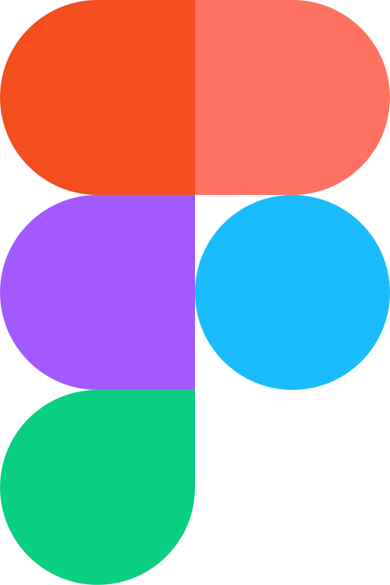
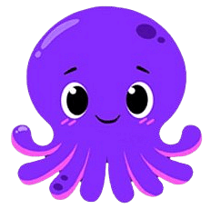




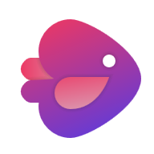
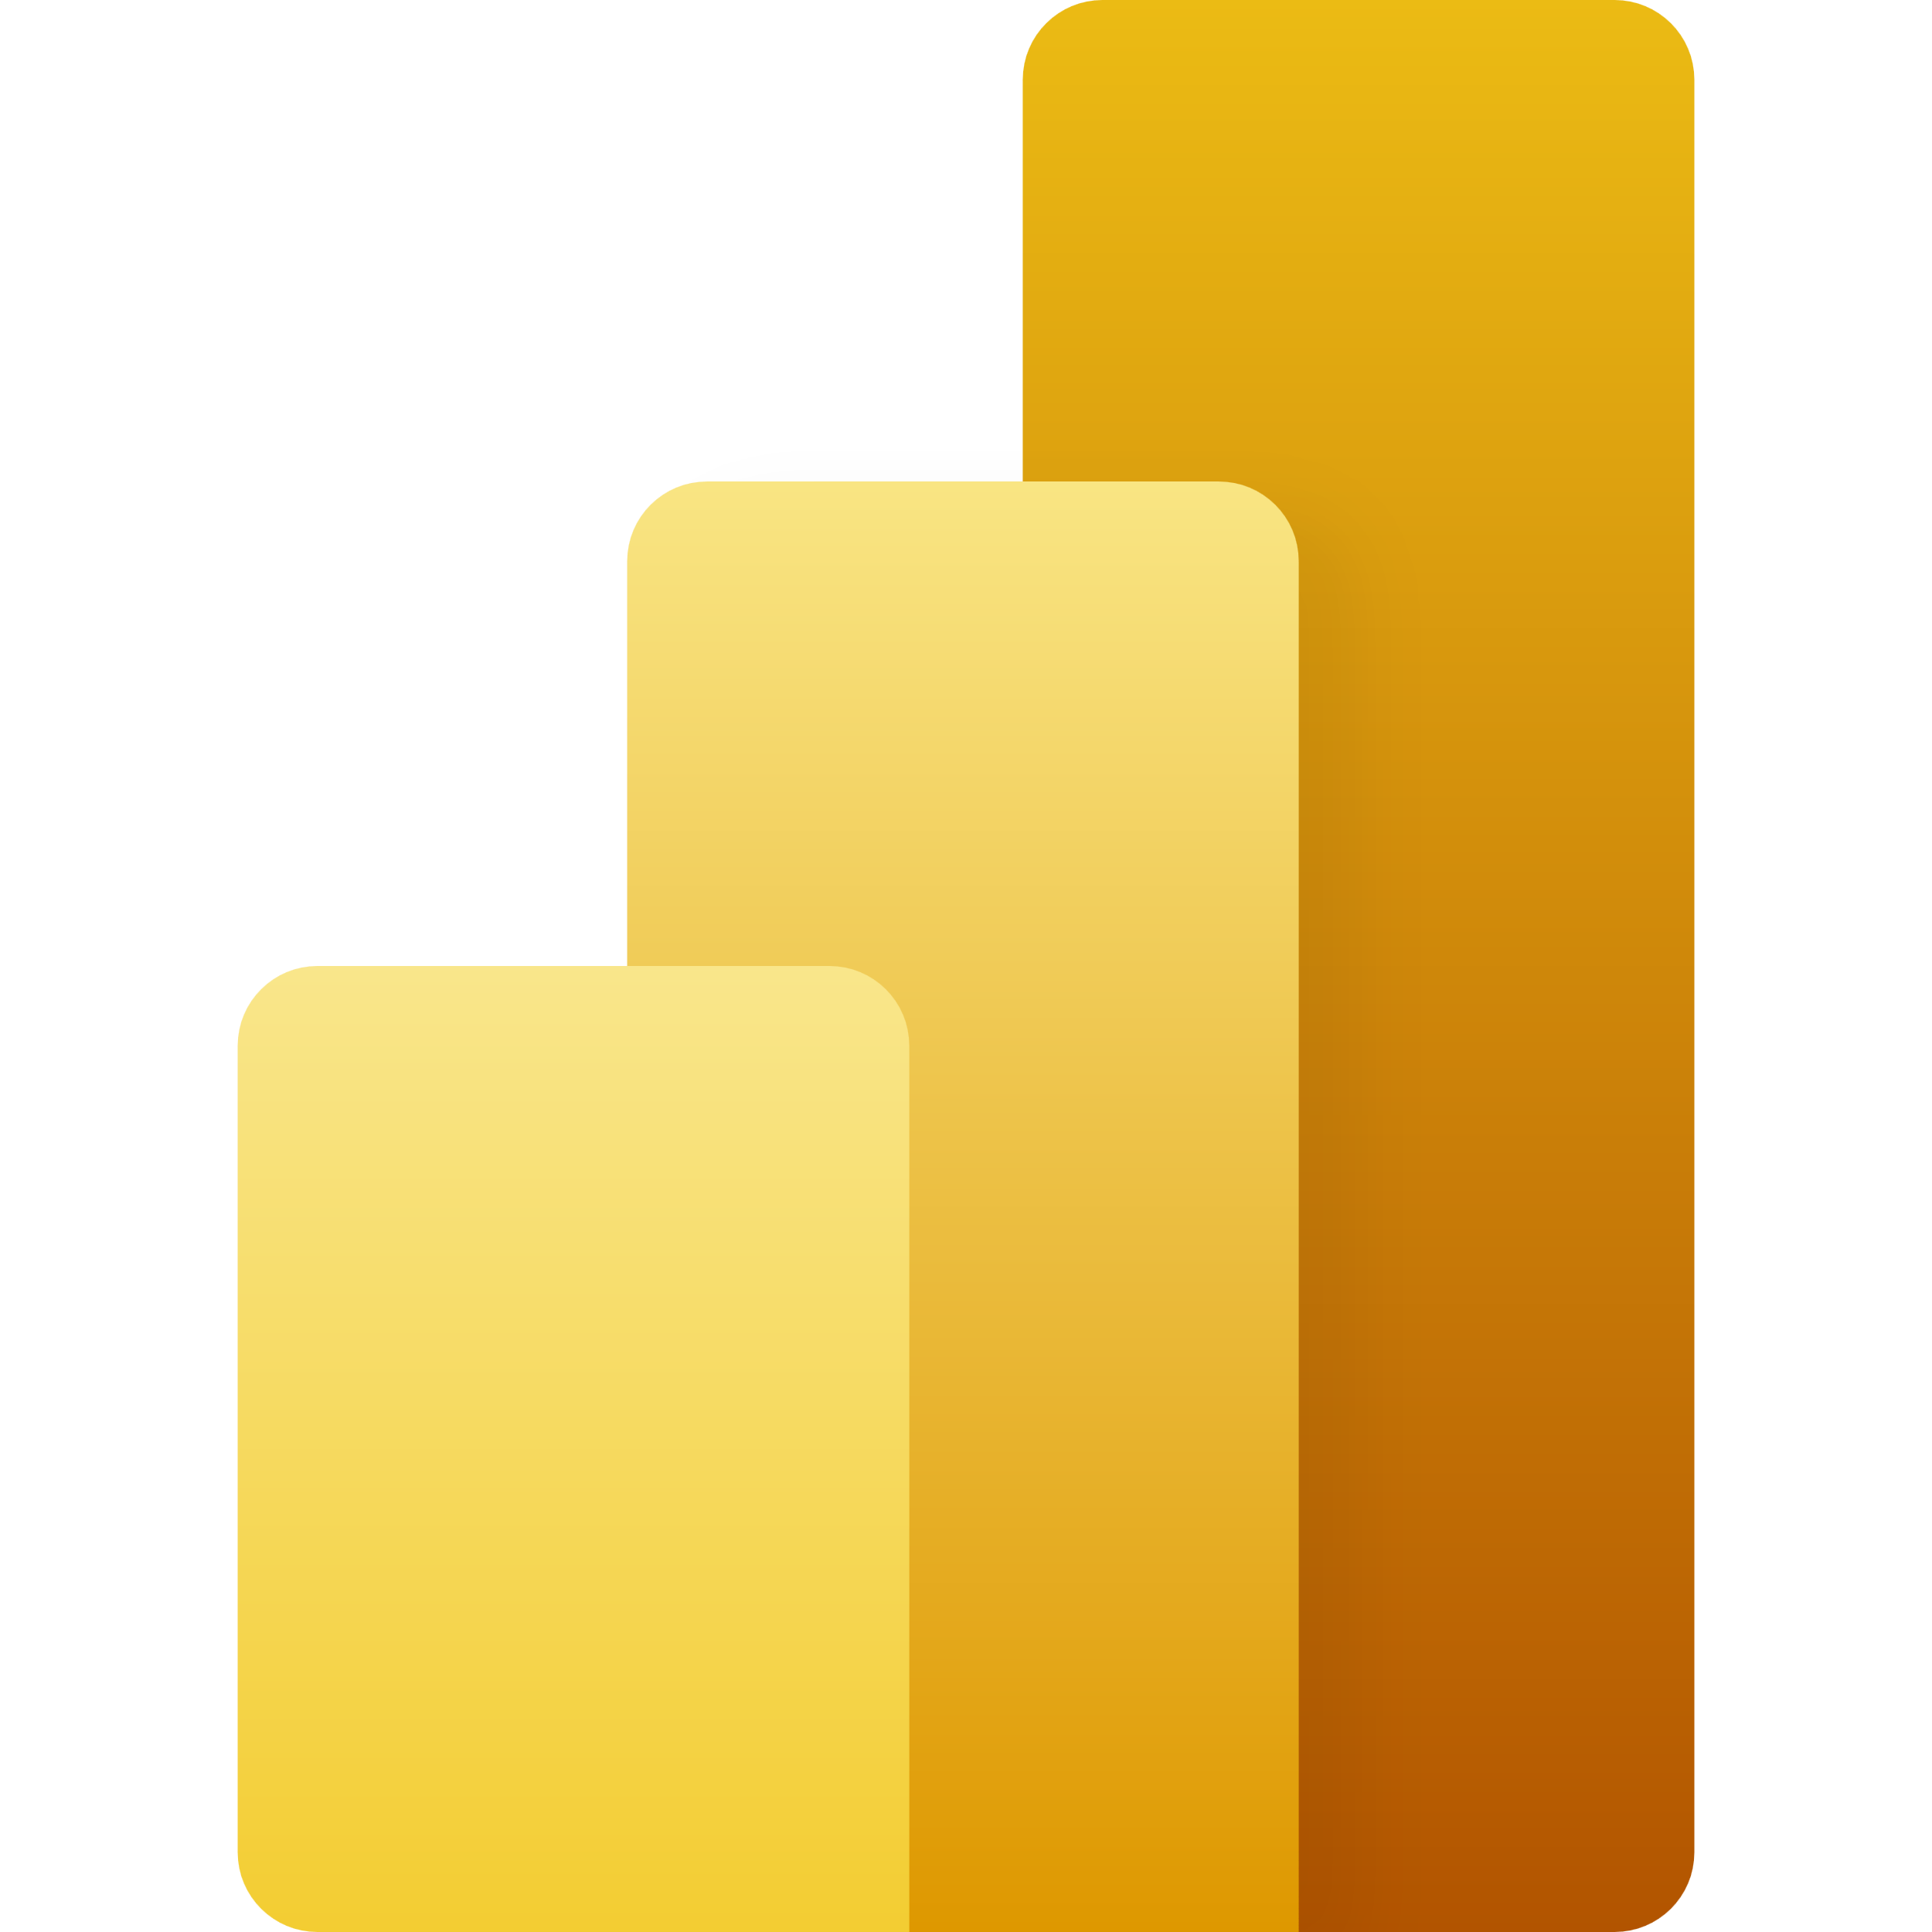
AI Tools We Use
PowerPoint Template
Content Creation
Design & Visuals
ChatGPT
Jasper
Midjourney
Canva
Grammarly
Shortly AI
Adobe Firefly
Figma
Video & Animation
Analytics & Automation
Pictory
Runway
Tableau AI
Zapier
Lumen5
InVideo
Dialogflow
Power BI

Slide 2




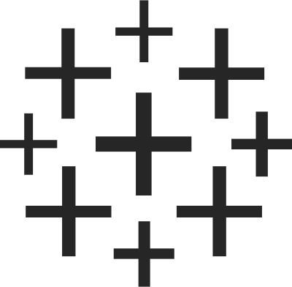

AI Tools We Use
PowerPoint Template
Content Creation
Design & Visuals
ChatGPT
Jasper
Midjourney
Canva
Grammarly
Shortly AI
Adobe Firefly
Figma
Video & Animation
Analytics & Automation
Pictory
Runway
Tableau AI
Zapier
Lumen5
InVideo
Dialogflow
Power BI

Slide 3


